Slide 1

Priyank Garg

Slide 2
Athlytics
Is a role-based web app program made for a reliable method for coaches to get workouts to student athletes
Useful in creating workouts
Useful in scheduling workouts
Notes:
Mar

Slide 3
Developed by
PRIYANK GARG
B.Tech (it)
Abes engg. College, ghaziabad
Notes:
Someone?????
We should probably say something about how our roles were not finalized but we stayed open in many aspects to help

Slide 4
The scope
Tracked progress of students
Showed progress in graphs
Allowed coaches to create workouts
Allowed coaches to have an easy platform to assign workout to teams with
Had students able to view these workouts
Could potentially extract graphs and results out of the student’s workouts
Mobile Application
Mobile friendly website
Priyank garg had visions of a program that
Notes:
adam

Slide 5
How and why to use
Two kinds of users: coaches or student athletes
Coaches will be able to create workouts for a team sport, even a scheduled time
The student will be able to view said workouts and times
This allows the student to do the team workout if the student is unavailable to do so at a scheduled time
Notes:
Tudor or Jinting

Slide 6
Use case diagram
Exercises
Workouts
Team
Student athletes
Coaches
Notes:
Adam

Slide 7
terminology
Uniform terms:
Workout: to talk about more then one exercise, or a group of exercises
Exercise: the particular movement or lift to be done
Sets: the amount/times required to be finished with particular exercise
Sport and team: are interchangeable
Notes:
Adam

Slide 8
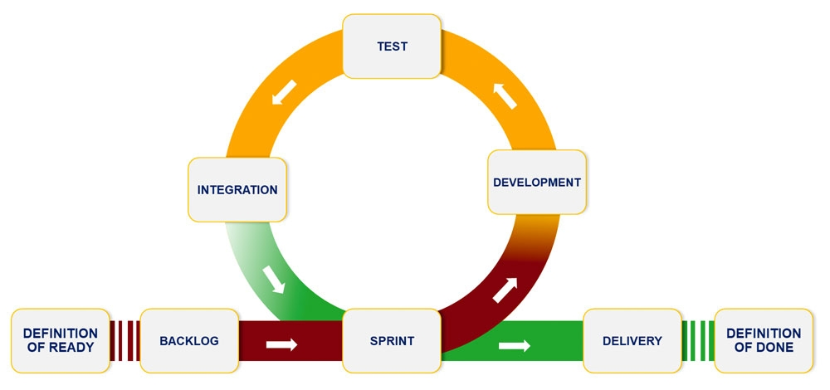
Agile development
Code and test to finish component
We used agile development so we could spread out and cover as much ground as we could in making the program
Implement the finished component to the main repository
Once again we would test.
Move to another piece
Pick something from the backlog
Notes:
Mar
Rather than Adam waiting on Alex to get done with a component, and Mar waiting for Adam to get done with the next component, ect ect we were able to work on many parts of the project as needed. Though this did mean that one or two instances of two people working on the same thing, but that is quickly caught

Slide 9
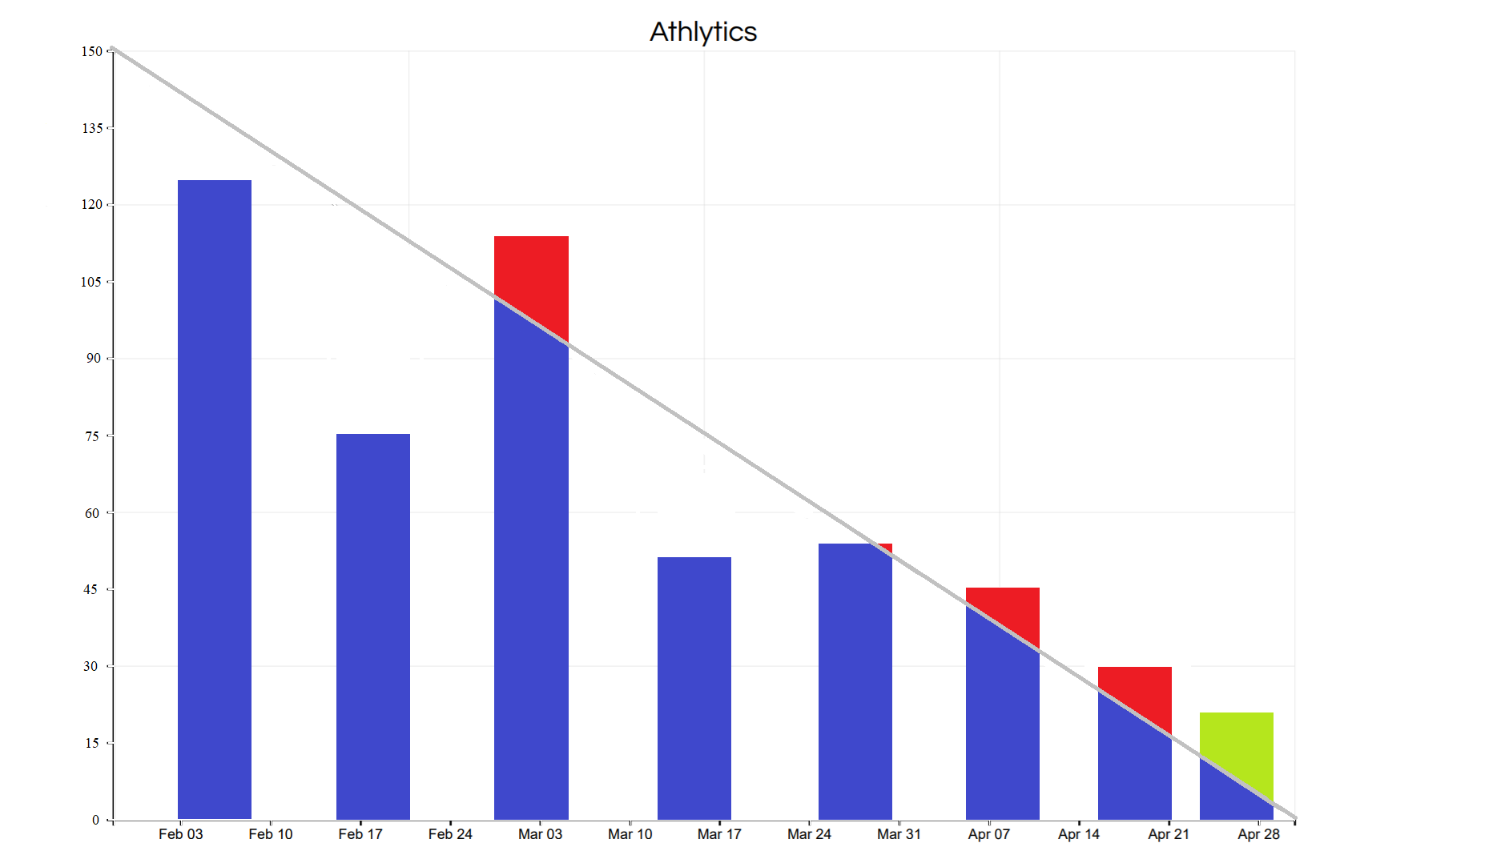
Burn down chart
Database tables set up Prospecting GUI layouts
We realized that the client wanted much more than we thought
8 sprints, one more than everyone thought
Dropped the mobile usage Scrapped a few unneeded functionality - like a “player card”
Personal issues caused delays and calendar falling behind
Some of the scrapped functionality
Notes:
Mar or Adam?
We had ups and downs.
The scrapped functionality can still be created at a later date after development,
The “player card” was going to be a “baseball card” that was home to the students profile, with picture, stats, and projected growth along with extra personalized options that the player would be able to change
When first planning on this project a number of risks we did not think of had came up preventing group discussion and getting tickets done.
What we did think of was more technical based, like Spring break, what if the database went down, what if our client changes his mind, we expected troubles from a non relational database, what if some code has to be scrapped, what if one of us gets injured?
Some of these that had happen was missing team meetings, switching from Material-UI to Semantic-UI, rewriting some code for a few components

Slide 10
Programming tools
Groupme for the quick communication and fast responses
slack for communication and file sharing
Version control: Github
Sprint management and board: github projects
Private repository- waiting to be public
Notes:
Jinting or Tudor
Group me is an app to chat with a group
Slack was immensity helpful for documentation for the quick file sharing, Adam and Jinting were able to work on the presentations on their own and then condense the two results
GitHub is the repository that everyone in the group uploaded the project to

Slide 11
Design
Designed a user interface prototype
Implemented the user interface using semantic-ui and material-ui for react
Done some ux/ui testing with some students and with our client
Notes:
Jinting

Slide 12
Coding
Role base authentication
The hardest part of the project was the ability to decipher between the coaches and students.
Javascript and why we picked it
React and why we picked it
Firebase and why we picked it
Semantic-ui and why we used it
Coding practices:
Camelcase naming conventions for variables
Used a program called lint
Notes:
Alex
Javascript was used because it is web application, and javascript is really useful for web applications.
We picked react because it streamlines the coding and testing process together.
We picked firebase because it is easy to alter tables that have no relations and that made it easy to add workouts and users, the hard part was relating them in a non-relational database
We used semantic-ui because it already had unbuilt components that should have made it easier to build the web app, but unfortunately these components are very fickle.
Lint formats and indents to make the code look more uniform.
We used uniform terms as not to get confused with Sets/Reps Workouts/exercises/lifts

Slide 13
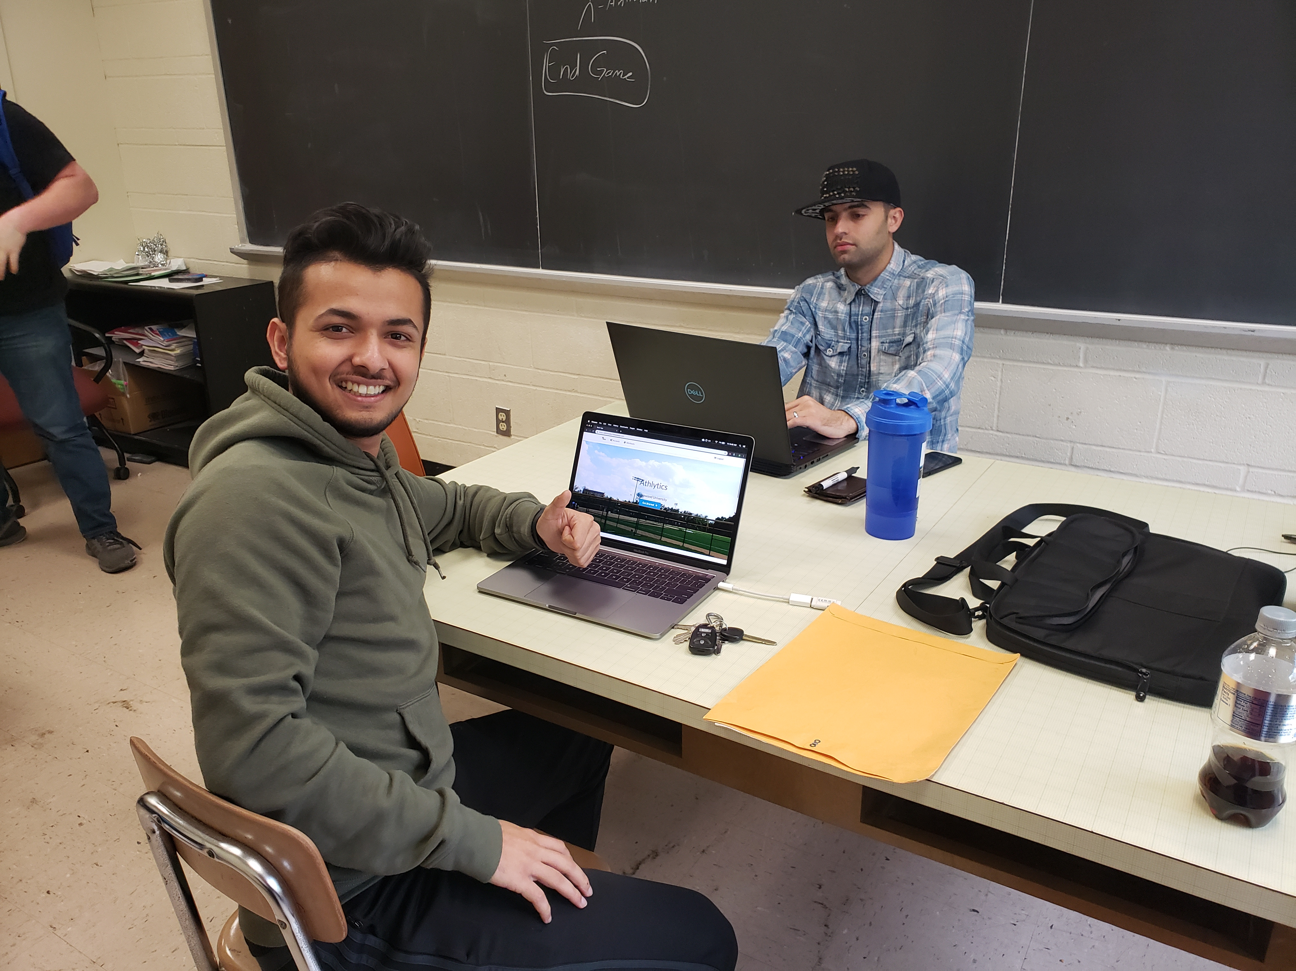
Testing PROBABLY user testing
Thanks to react, the testing done while coding
During coding the web page would change once a new line of code was written/altered
User testing
Amirhossein Shahri
Prabin regmi –”its cool”
students around school
Notes:
Adam

Slide 14
Deployment
We used npm to get a production build of our react app
We used firebase hosting to upload our production build to the cloud and have it accessible to all the users through the web
Created a deployment routine where we just need to execute a command to quickly redeploy our project to production
Notes:
Mar

Slide 15
google Firebase as database
Security
Passwords are naturally Encrypted
Email verifications for registering
Easy ability for passwords resets, which prompt email verification
Offers hosting solution for production deployment
Notes:
Alex
Talk about the easy database changes that can made thanks to fire base

Slide 16
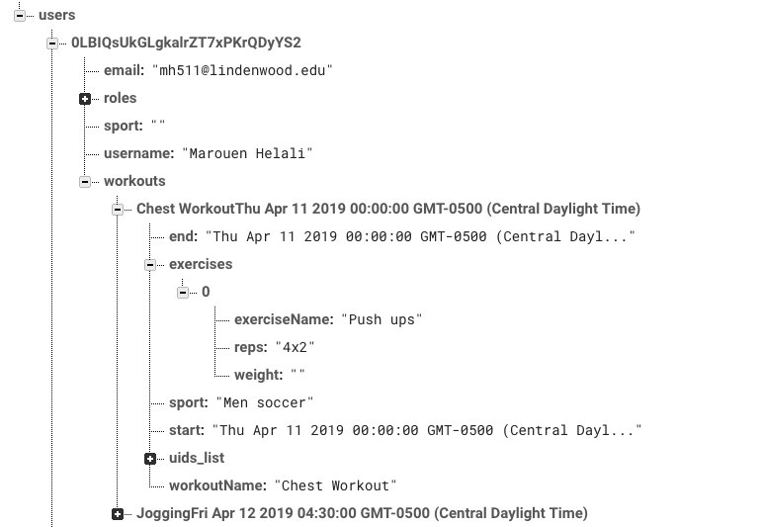
How the database is set up
Note that Firebase is a non-relational database so there is no real relations
means that there is not a true E/R diagram
Notes:
Alex

Slide 17
How to use
Like many web based programs, you will have to sign up
Verify your email and create a password – secured and safe
If a new coach wishes to sign up the client needs to give you the admin secret seed
It is simple as following this link https://athlytics5g.firebaseapp.com/
Notes:
Tudor
But before we show you the functions of Athlytics something something something next slide

Slide 18
Demonstration
Notes:
Jinting

Slide 19
Retrospective
Don’t rely on your team but trust your team
We learned react, semantic-ui, firebase, role-based authentication
Learning github – version control - to do the group project
Patience on everything, trust the team
Do as much as you can so your team has to do less
Notes:
Jinting

Slide 20
What went wrong
underestimating how large the scope really was.
New ideas and features were thought of for the project during development thus making the project scope even larger.
Illnesses, personal problems causing some features to not be completed and implemented on time.
Changing between Material-UI to Semantic-UI caused a few hiccups and code to be scrapped
Notes:
Alex
The illnesses part should mention that not meeting these features on time caused us to miss a milestone deadline **this is a buzz word use it

Slide 21
What went right
The team members were able interchangeably work with each others code
everyone seemed calm even close to the end.
The use of Firebase made the creation of the database fairly simple and allowed the incredibly easy implementation of admin accounts and user accounts.
that passwords are also naturally encrypted ensuring network safety
Notes:
Tudor

Slide 22
What we would do differently
the team would be a bit quicker to start coding and thus making progression quicker, making milestones more easily.
longer meetings could be useful, where we would get to some of the things discussed in the team meeting done during the meeting.
Having more team members involved directly with the code
Notes:
Mar

